Slide 1


2057 Demographic Methods
Practical 3:
Life Tables 1
16/10/2025
Julio E Romero Prieto

Slide 2
1. Life table for an unspecified West African population, 1975
x | _{n}m_{x} | n | _{n}a_{x} | _{n}q_{x} | _{n}p_{x} | l_{x} | _{n}d_{x} | _{n}L_{x} | T_{x} | e_{x}
0 | 0.22650
1 | 0.03430
5 | 0.00198
10 | 0.00038
15 | 0.00180
20 | 0.00252
25 | 0.00290
30 | 0.00318
35 | 0.00352
40 | 0.00390
45 | 0.00454
50 | 0.00490
55 | 0.00622
60 | 0.00998
65 | 0.02066
70 | 0.06748
75+ | 0.31780

Slide 3
1. Life table for an unspecified West African population, 1975
x | _{n}m_{x} | n | _{n}a_{x} | _{n}q_{x} | _{n}p_{x} | l_{x} | _{n}d_{x} | _{n}L_{x} | T_{x} | e_{x}
0 | 0.22650 | 1
1 | 0.03430 | 4
5 | 0.00198 | 5
10 | 0.00038 | 5
15 | 0.00180 | 5
20 | 0.00252 | 5
25 | 0.00290 | 5
30 | 0.00318 | 5
35 | 0.00352 | 5
40 | 0.00390 | 5
45 | 0.00454 | 5
50 | 0.00490 | 5
55 | 0.00622 | 5
60 | 0.00998 | 5
65 | 0.02066 | 5
70 | 0.06748 | 5
75+ | 0.31780
1. Use x to calculate n

Slide 4
1. Life table for an unspecified West African population, 1975
x | _{n}m_{x} | n | _{n}a_{x} | _{n}q_{x} | _{n}p_{x} | l_{x} | _{n}d_{x} | _{n}L_{x} | T_{x} | e_{x}
0 | 0.22650 | 1 | 0.3
1 | 0.03430 | 4 | 0.4
5 | 0.00198 | 5
10 | 0.00038 | 5
15 | 0.00180 | 5
20 | 0.00252 | 5
25 | 0.00290 | 5
30 | 0.00318 | 5
35 | 0.00352 | 5
40 | 0.00390 | 5
45 | 0.00454 | 5
50 | 0.00490 | 5
55 | 0.00622 | 5
60 | 0.00998 | 5
65 | 0.02066 | 5
70 | 0.06748 | 5
75+ | 0.31780
West African population in 1975
High level of mortality, as indicated by ₁m₀.
2. Assume corresponding values for ₁a₀ and ₄a₁.

Slide 5
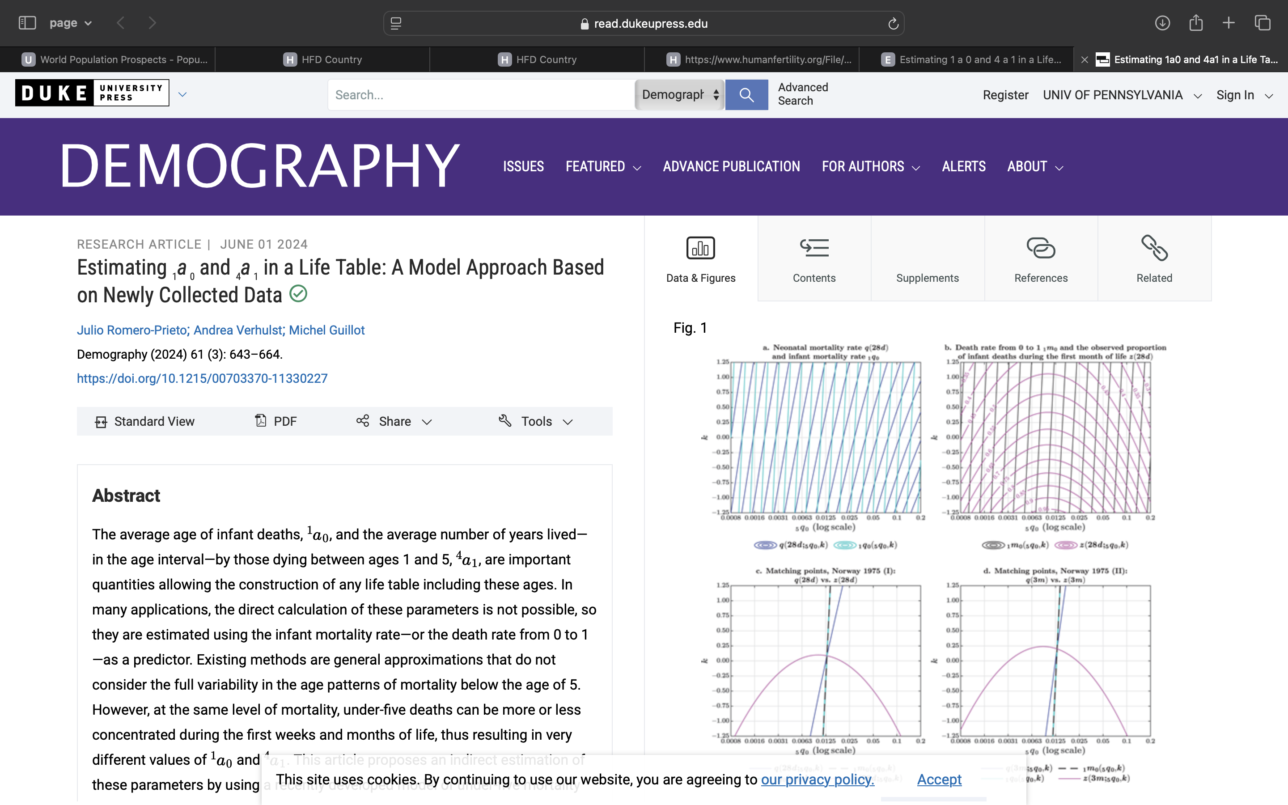
1. Life table for an unspecified West African population, 1975
https://doi.org/10.1215/00703370-11330227

Slide 6
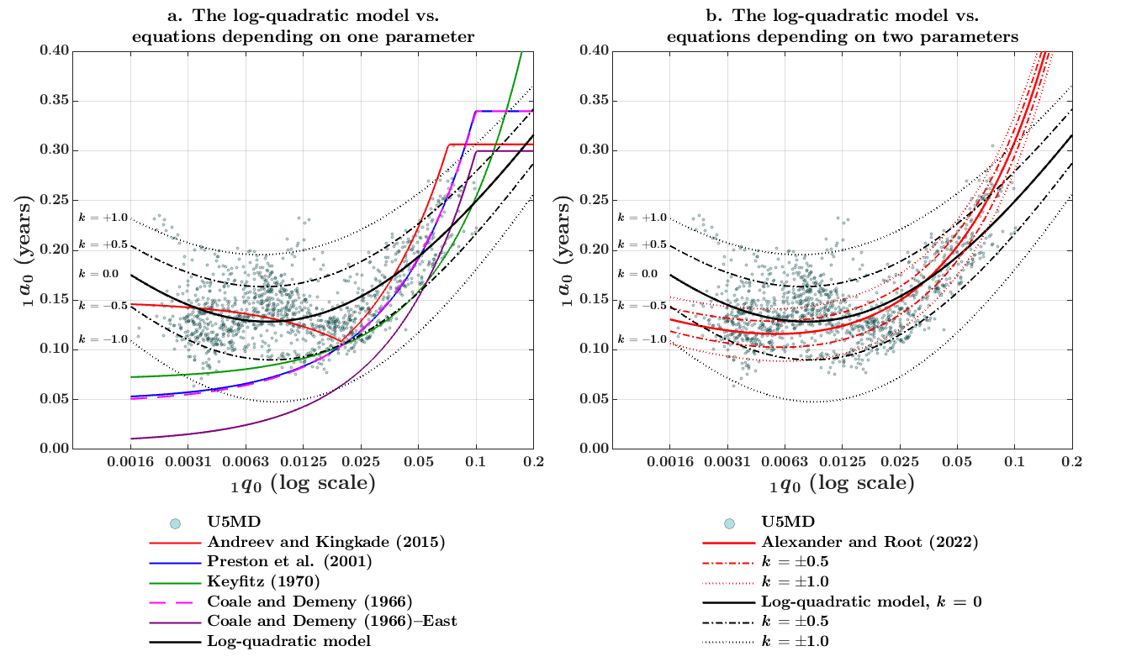
1. Life table for an unspecified West African population, 1975
https://doi.org/10.1215/00703370-11330227

Slide 7
1. Life table for an unspecified West African population, 1975
x | _{n}m_{x} | n | _{n}a_{x} | _{n}q_{x} | _{n}p_{x} | l_{x} | _{n}d_{x} | _{n}L_{x} | T_{x} | e_{x}
0 | 0.22650 | 1 | 0.3
1 | 0.03430 | 4 | 0.4
5 | 0.00198 | 5 | 0.5
10 | 0.00038 | 5 | 0.5
15 | 0.00180 | 5 | 0.5
20 | 0.00252 | 5 | 0.5
25 | 0.00290 | 5 | 0.5
30 | 0.00318 | 5 | 0.5
35 | 0.00352 | 5 | 0.5
40 | 0.00390 | 5 | 0.5
45 | 0.00454 | 5 | 0.5
50 | 0.00490 | 5 | 0.5
55 | 0.00622 | 5 | 0.5
60 | 0.00998 | 5 | 0.5
65 | 0.02066 | 5 | 0.5
70 | 0.06748 | 5 | 0.5
75+ | 0.31780
3. Assume corresponding values for ₅a_{x} = 0.5, as a rule of thumb.

Slide 8
1. Life table for an unspecified West African population, 1975
x | _{n}m_{x} | n | _{n}a_{x} | _{n}q_{x} | _{n}p_{x} | l_{x} | _{n}d_{x} | _{n}L_{x} | T_{x} | e_{x}
0 | 0.22650 | 1 | 0.3
1 | 0.03430 | 4 | 0.4
5 | 0.00198 | 5 | 0.5
10 | 0.00038 | 5 | 0.5
15 | 0.00180 | 5 | 0.5
20 | 0.00252 | 5 | 0.5
25 | 0.00290 | 5 | 0.5
30 | 0.00318 | 5 | 0.5
35 | 0.00352 | 5 | 0.5
40 | 0.00390 | 5 | 0.5
45 | 0.00454 | 5 | 0.5
50 | 0.00490 | 5 | 0.5
55 | 0.00622 | 5 | 0.5
60 | 0.00998 | 5 | 0.5
65 | 0.02066 | 5 | 0.5
70 | 0.06748 | 5 | 0.5
75+ | 0.31780
Some alternatives:
Use formulae for ₁a₀ and ₄a₁ as a function of ₁m₀.
Graduation of ₅a_{x}.
Import values from another life table.

Slide 9
1. Life table for an unspecified West African population, 1975
x | _{n}m_{x} | n | _{n}a_{x} | _{n}q_{x} | _{n}p_{x} | l_{x} | _{n}d_{x} | _{n}L_{x} | T_{x} | e_{x}
0 | 0.22650 | 1 | 0.3
1 | 0.03430 | 4 | 0.4
5 | 0.00198 | 5 | 0.5
10 | 0.00038 | 5 | 0.5
15 | 0.00180 | 5 | 0.5
20 | 0.00252 | 5 | 0.5
25 | 0.00290 | 5 | 0.5
30 | 0.00318 | 5 | 0.5
35 | 0.00352 | 5 | 0.5
40 | 0.00390 | 5 | 0.5
45 | 0.00454 | 5 | 0.5
50 | 0.00490 | 5 | 0.5
55 | 0.00622 | 5 | 0.5
60 | 0.00998 | 5 | 0.5
65 | 0.02066 | 5 | 0.5
70 | 0.06748 | 5 | 0.5
75+ | 0.31780
A word of caution:
In some textbooks, _{n}a_{x} is a duration rather than a proportion (e.g., Preston et al.).
From that perspective, _{n}a_{x} < n is defined as the average number of years lived by those dying within the age interval.

Slide 10
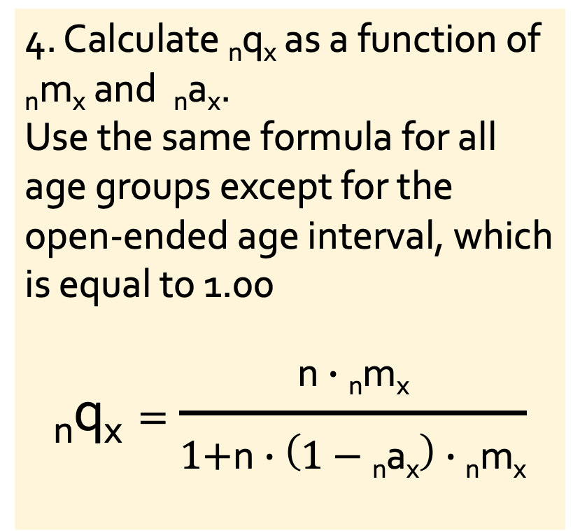
1. Life table for an unspecified West African population, 1975
x | _{n}m_{x} | n | _{n}a_{x} | _{n}q_{x} | _{n}p_{x} | l_{x} | _{n}d_{x} | _{n}L_{x} | T_{x} | e_{x}
0 | 0.22650 | 1 | 0.3 | 0.19550
1 | 0.03430 | 4 | 0.4 | 0.12676
5 | 0.00198 | 5 | 0.5 | 0.00985
10 | 0.00038 | 5 | 0.5 | 0.00190
15 | 0.00180 | 5 | 0.5 | 0.00896
20 | 0.00252 | 5 | 0.5 | 0.01252
25 | 0.00290 | 5 | 0.5 | 0.01440
30 | 0.00318 | 5 | 0.5 | 0.01577
35 | 0.00352 | 5 | 0.5 | 0.01745
40 | 0.00390 | 5 | 0.5 | 0.01931
45 | 0.00454 | 5 | 0.5 | 0.02245
50 | 0.00490 | 5 | 0.5 | 0.02420
55 | 0.00622 | 5 | 0.5 | 0.03062
60 | 0.00998 | 5 | 0.5 | 0.04869
65 | 0.02066 | 5 | 0.5 | 0.09823
70 | 0.06748 | 5 | 0.5 | 0.28870
75+ | 0.31780 |  |  | 1.00000
4. Calculate _{n}q_{x} as a function of _{n}m_{x} and _{n}a_{x}.
Use the same formula for all age groups except for the open-ended age interval, which is equal to 1.00
$$\text{n}\text{q}\text{x}=\frac{\text{n}∙\text{n}\text{m}\text{x}}{\text{1+}\text{n}∙\left(1−\text{n}\text{a}\text{x}\right)∙\text{n}\text{m}\text{x}}$$

Slide 11
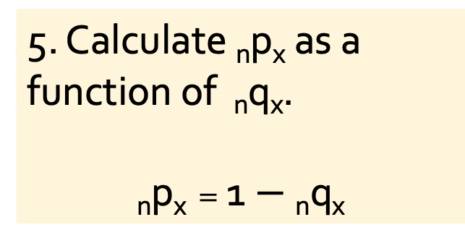
1. Life table for an unspecified West African population, 1975
x | _{n}m_{x} | n | _{n}a_{x} | _{n}q_{x} | _{n}p_{x} | l_{x} | _{n}d_{x} | _{n}L_{x} | T_{x} | e_{x}
0 | 0.22650 | 1 | 0.3 | 0.19550 | 0.80450
1 | 0.03430 | 4 | 0.4 | 0.12676 | 0.87324
5 | 0.00198 | 5 | 0.5 | 0.00985 | 0.99015
10 | 0.00038 | 5 | 0.5 | 0.00190 | 0.99810
15 | 0.00180 | 5 | 0.5 | 0.00896 | 0.99104
20 | 0.00252 | 5 | 0.5 | 0.01252 | 0.98748
25 | 0.00290 | 5 | 0.5 | 0.01440 | 0.98560
30 | 0.00318 | 5 | 0.5 | 0.01577 | 0.98423
35 | 0.00352 | 5 | 0.5 | 0.01745 | 0.98255
40 | 0.00390 | 5 | 0.5 | 0.01931 | 0.98069
45 | 0.00454 | 5 | 0.5 | 0.02245 | 0.97755
50 | 0.00490 | 5 | 0.5 | 0.02420 | 0.97580
55 | 0.00622 | 5 | 0.5 | 0.03062 | 0.96938
60 | 0.00998 | 5 | 0.5 | 0.04869 | 0.95131
65 | 0.02066 | 5 | 0.5 | 0.09823 | 0.90177
70 | 0.06748 | 5 | 0.5 | 0.28870 | 0.71130
75+ | 0.31780 |  |  | 1.00000 | 0.00000
5. Calculate _{n}p_{x} as a function of _{n}q_{x}.
$$\text{n}\text{p}\text{x}=\text{1}−\text{n}\text{q}\text{x}$$

Slide 12

1. Life table for an unspecified West African population, 1975
x | _{n}m_{x} | n | _{n}a_{x} | _{n}q_{x} | _{n}p_{x} | l_{x} | _{n}d_{x} | _{n}L_{x} | T_{x} | e_{x}
0 | 0.22650 | 1 | 0.3 | 0.19550 | 0.80450 | 100,000
1 | 0.03430 | 4 | 0.4 | 0.12676 | 0.87324 | 80,450
5 | 0.00198 | 5 | 0.5 | 0.00985 | 0.99015
10 | 0.00038 | 5 | 0.5 | 0.00190 | 0.99810
15 | 0.00180 | 5 | 0.5 | 0.00896 | 0.99104
20 | 0.00252 | 5 | 0.5 | 0.01252 | 0.98748
25 | 0.00290 | 5 | 0.5 | 0.01440 | 0.98560
30 | 0.00318 | 5 | 0.5 | 0.01577 | 0.98423
35 | 0.00352 | 5 | 0.5 | 0.01745 | 0.98255
40 | 0.00390 | 5 | 0.5 | 0.01931 | 0.98069
45 | 0.00454 | 5 | 0.5 | 0.02245 | 0.97755
50 | 0.00490 | 5 | 0.5 | 0.02420 | 0.97580
55 | 0.00622 | 5 | 0.5 | 0.03062 | 0.96938
60 | 0.00998 | 5 | 0.5 | 0.04869 | 0.95131
65 | 0.02066 | 5 | 0.5 | 0.09823 | 0.90177
70 | 0.06748 | 5 | 0.5 | 0.28870 | 0.71130
75+ | 0.31780 |  |  | 1.00000 | 0.00000
6. Calculate l_{x} as a function of _{n}p_{x}.
$$\text{l}\text{x}\text{+}\text{n}=\text{l}\text{x}∙\text{n}\text{p}\text{x}$$

Slide 13
1. Life table for an unspecified West African population, 1975
x | _{n}m_{x} | n | _{n}a_{x} | _{n}q_{x} | _{n}p_{x} | l_{x} | _{n}d_{x} | _{n}L_{x} | T_{x} | e_{x}
0 | 0.22650 | 1 | 0.3 | 0.19550 | 0.80450 | 100,000
1 | 0.03430 | 4 | 0.4 | 0.12676 | 0.87324 | 80,450
5 | 0.00198 | 5 | 0.5 | 0.00985 | 0.99015 | 70,252
10 | 0.00038 | 5 | 0.5 | 0.00190 | 0.99810
15 | 0.00180 | 5 | 0.5 | 0.00896 | 0.99104
20 | 0.00252 | 5 | 0.5 | 0.01252 | 0.98748
25 | 0.00290 | 5 | 0.5 | 0.01440 | 0.98560
30 | 0.00318 | 5 | 0.5 | 0.01577 | 0.98423
35 | 0.00352 | 5 | 0.5 | 0.01745 | 0.98255
40 | 0.00390 | 5 | 0.5 | 0.01931 | 0.98069
45 | 0.00454 | 5 | 0.5 | 0.02245 | 0.97755
50 | 0.00490 | 5 | 0.5 | 0.02420 | 0.97580
55 | 0.00622 | 5 | 0.5 | 0.03062 | 0.96938
60 | 0.00998 | 5 | 0.5 | 0.04869 | 0.95131
65 | 0.02066 | 5 | 0.5 | 0.09823 | 0.90177
70 | 0.06748 | 5 | 0.5 | 0.28870 | 0.71130
75+ | 0.31780 |  |  | 1.00000 | 0.00000
6. Calculate l_{x} as a function of _{n}p_{x}.
$$\text{l}\text{x}\text{+}\text{n}=\text{l}\text{x}∙\text{n}\text{p}\text{x}$$

Slide 14
1. Life table for an unspecified West African population, 1975
x | _{n}m_{x} | n | _{n}a_{x} | _{n}q_{x} | _{n}p_{x} | l_{x} | _{n}d_{x} | _{n}L_{x} | T_{x} | e_{x}
0 | 0.22650 | 1 | 0.3 | 0.19550 | 0.80450 | 100,000
1 | 0.03430 | 4 | 0.4 | 0.12676 | 0.87324 | 80,450
5 | 0.00198 | 5 | 0.5 | 0.00985 | 0.99015 | 70,252
10 | 0.00038 | 5 | 0.5 | 0.00190 | 0.99810 | 69,559
15 | 0.00180 | 5 | 0.5 | 0.00896 | 0.99104 | 69,427
20 | 0.00252 | 5 | 0.5 | 0.01252 | 0.98748 | 68,805
25 | 0.00290 | 5 | 0.5 | 0.01440 | 0.98560 | 67,944
30 | 0.00318 | 5 | 0.5 | 0.01577 | 0.98423 | 66,966
35 | 0.00352 | 5 | 0.5 | 0.01745 | 0.98255 | 65,909
40 | 0.00390 | 5 | 0.5 | 0.01931 | 0.98069 | 64,760
45 | 0.00454 | 5 | 0.5 | 0.02245 | 0.97755 | 63,509
50 | 0.00490 | 5 | 0.5 | 0.02420 | 0.97580 | 62,083
55 | 0.00622 | 5 | 0.5 | 0.03062 | 0.96938 | 60,581
60 | 0.00998 | 5 | 0.5 | 0.04869 | 0.95131 | 58,726
65 | 0.02066 | 5 | 0.5 | 0.09823 | 0.90177 | 55,866
70 | 0.06748 | 5 | 0.5 | 0.28870 | 0.71130 | 50,379
75+ | 0.31780 |  |  | 1.00000 | 0.00000 | 35,835
6. Calculate l_{x} as a function of _{n}p_{x}.
$$\text{l}\text{x}\text{+}\text{n}=\text{l}\text{x}∙\text{n}\text{p}\text{x}$$

Slide 15
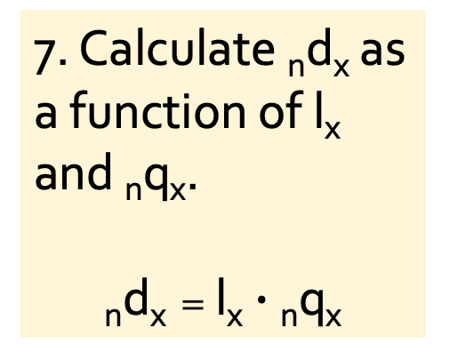
1. Life table for an unspecified West African population, 1975
x | _{n}m_{x} | n | _{n}a_{x} | _{n}q_{x} | _{n}p_{x} | l_{x} | _{n}d_{x} | _{n}L_{x} | T_{x} | e_{x}
0 | 0.22650 | 1 | 0.3 | 0.19550 | 0.80450 | 100,000 | 19,550
1 | 0.03430 | 4 | 0.4 | 0.12676 | 0.87324 | 80,450 | 10,198
5 | 0.00198 | 5 | 0.5 | 0.00985 | 0.99015 | 70,252 | 692
10 | 0.00038 | 5 | 0.5 | 0.00190 | 0.99810 | 69,559 | 132
15 | 0.00180 | 5 | 0.5 | 0.00896 | 0.99104 | 69,427 | 622
20 | 0.00252 | 5 | 0.5 | 0.01252 | 0.98748 | 68,805 | 862
25 | 0.00290 | 5 | 0.5 | 0.01440 | 0.98560 | 67,944 | 978
30 | 0.00318 | 5 | 0.5 | 0.01577 | 0.98423 | 66,966 | 1,056
35 | 0.00352 | 5 | 0.5 | 0.01745 | 0.98255 | 65,909 | 1,150
40 | 0.00390 | 5 | 0.5 | 0.01931 | 0.98069 | 64,760 | 1,251
45 | 0.00454 | 5 | 0.5 | 0.02245 | 0.97755 | 63,509 | 1,425
50 | 0.00490 | 5 | 0.5 | 0.02420 | 0.97580 | 62,083 | 1,503
55 | 0.00622 | 5 | 0.5 | 0.03062 | 0.96938 | 60,581 | 1,855
60 | 0.00998 | 5 | 0.5 | 0.04869 | 0.95131 | 58,726 | 2,859
65 | 0.02066 | 5 | 0.5 | 0.09823 | 0.90177 | 55,866 | 5,488
70 | 0.06748 | 5 | 0.5 | 0.28870 | 0.71130 | 50,379 | 14,544
75+ | 0.31780 |  |  | 1.00000 | 0.00000 | 35,835 | 35,835
7. Calculate _{n}d_{x} as a function of l_{x} and _{n}q_{x}.
$$\text{n}\text{d}\text{x}=\text{l}\text{x}∙\text{n}\text{q}\text{x}$$

Slide 16
1. Life table for an unspecified West African population, 1975
x | _{n}m_{x} | n | _{n}a_{x} | _{n}q_{x} | _{n}p_{x} | l_{x} | _{n}d_{x} | _{n}L_{x} | T_{x} | e_{x}
0 | 0.22650 | 1 | 0.3 | 0.19550 | 0.80450 | 100,000 | 19,550
1 | 0.03430 | 4 | 0.4 | 0.12676 | 0.87324 | 80,450 | 10,198
5 | 0.00198 | 5 | 0.5 | 0.00985 | 0.99015 | 70,252 | 692
10 | 0.00038 | 5 | 0.5 | 0.00190 | 0.99810 | 69,559 | 132
15 | 0.00180 | 5 | 0.5 | 0.00896 | 0.99104 | 69,427 | 622
20 | 0.00252 | 5 | 0.5 | 0.01252 | 0.98748 | 68,805 | 862
25 | 0.00290 | 5 | 0.5 | 0.01440 | 0.98560 | 67,944 | 978
30 | 0.00318 | 5 | 0.5 | 0.01577 | 0.98423 | 66,966 | 1,056
35 | 0.00352 | 5 | 0.5 | 0.01745 | 0.98255 | 65,909 | 1,150
40 | 0.00390 | 5 | 0.5 | 0.01931 | 0.98069 | 64,760 | 1,251
45 | 0.00454 | 5 | 0.5 | 0.02245 | 0.97755 | 63,509 | 1,425
50 | 0.00490 | 5 | 0.5 | 0.02420 | 0.97580 | 62,083 | 1,503
55 | 0.00622 | 5 | 0.5 | 0.03062 | 0.96938 | 60,581 | 1,855
60 | 0.00998 | 5 | 0.5 | 0.04869 | 0.95131 | 58,726 | 2,859
65 | 0.02066 | 5 | 0.5 | 0.09823 | 0.90177 | 55,866 | 5,488
70 | 0.06748 | 5 | 0.5 | 0.28870 | 0.71130 | 50,379 | 14,544
75+ | 0.31780 |  |  | 1.00000 | 0.00000 | 35,835 | 35,835
As a check, note that _{n}d_{x} and l_{x} have the same value at the open-ended age interval.

Slide 17
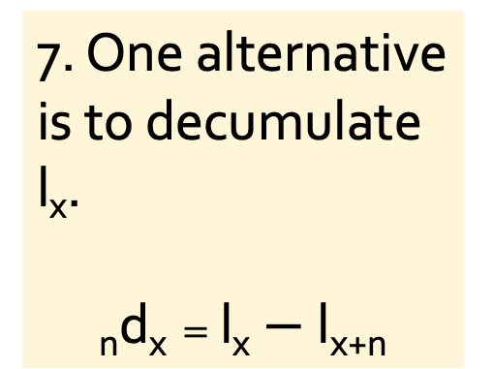
1. Life table for an unspecified West African population, 1975
x | _{n}m_{x} | n | _{n}a_{x} | _{n}q_{x} | _{n}p_{x} | l_{x} | _{n}d_{x} | _{n}L_{x} | T_{x} | e_{x}
0 | 0.22650 | 1 | 0.3 | 0.19550 | 0.80450 | 100,000 | 19,550
1 | 0.03430 | 4 | 0.4 | 0.12676 | 0.87324 | 80,450
5 | 0.00198 | 5 | 0.5 | 0.00985 | 0.99015 | 70,252
10 | 0.00038 | 5 | 0.5 | 0.00190 | 0.99810 | 69,559
15 | 0.00180 | 5 | 0.5 | 0.00896 | 0.99104 | 69,427
20 | 0.00252 | 5 | 0.5 | 0.01252 | 0.98748 | 68,805
25 | 0.00290 | 5 | 0.5 | 0.01440 | 0.98560 | 67,944
30 | 0.00318 | 5 | 0.5 | 0.01577 | 0.98423 | 66,966
35 | 0.00352 | 5 | 0.5 | 0.01745 | 0.98255 | 65,909
40 | 0.00390 | 5 | 0.5 | 0.01931 | 0.98069 | 64,760
45 | 0.00454 | 5 | 0.5 | 0.02245 | 0.97755 | 63,509
50 | 0.00490 | 5 | 0.5 | 0.02420 | 0.97580 | 62,083
55 | 0.00622 | 5 | 0.5 | 0.03062 | 0.96938 | 60,581
60 | 0.00998 | 5 | 0.5 | 0.04869 | 0.95131 | 58,726
65 | 0.02066 | 5 | 0.5 | 0.09823 | 0.90177 | 55,866
70 | 0.06748 | 5 | 0.5 | 0.28870 | 0.71130 | 50,379
75+ | 0.31780 |  |  | 1.00000 | 0.00000 | 35,835
7. One alternative is to decumulate l_{x}.
$$\text{n}\text{d}\text{x}=\text{l}\text{x}−\text{l}\text{x}\text{+}\text{n}$$

Slide 18
1. Life table for an unspecified West African population, 1975
x | _{n}m_{x} | n | _{n}a_{x} | _{n}q_{x} | _{n}p_{x} | l_{x} | _{n}d_{x} | _{n}L_{x} | T_{x} | e_{x}
0 | 0.22650 | 1 | 0.3 | 0.19550 | 0.80450 | 100,000 | 19,550
1 | 0.03430 | 4 | 0.4 | 0.12676 | 0.87324 | 80,450 | 10,198
5 | 0.00198 | 5 | 0.5 | 0.00985 | 0.99015 | 70,252
10 | 0.00038 | 5 | 0.5 | 0.00190 | 0.99810 | 69,559
15 | 0.00180 | 5 | 0.5 | 0.00896 | 0.99104 | 69,427
20 | 0.00252 | 5 | 0.5 | 0.01252 | 0.98748 | 68,805
25 | 0.00290 | 5 | 0.5 | 0.01440 | 0.98560 | 67,944
30 | 0.00318 | 5 | 0.5 | 0.01577 | 0.98423 | 66,966
35 | 0.00352 | 5 | 0.5 | 0.01745 | 0.98255 | 65,909
40 | 0.00390 | 5 | 0.5 | 0.01931 | 0.98069 | 64,760
45 | 0.00454 | 5 | 0.5 | 0.02245 | 0.97755 | 63,509
50 | 0.00490 | 5 | 0.5 | 0.02420 | 0.97580 | 62,083
55 | 0.00622 | 5 | 0.5 | 0.03062 | 0.96938 | 60,581
60 | 0.00998 | 5 | 0.5 | 0.04869 | 0.95131 | 58,726
65 | 0.02066 | 5 | 0.5 | 0.09823 | 0.90177 | 55,866
70 | 0.06748 | 5 | 0.5 | 0.28870 | 0.71130 | 50,379
75+ | 0.31780 |  |  | 1.00000 | 0.00000 | 35,835
7. One alternative is to decumulate l_{x}.
$$\text{n}\text{d}\text{x}=\text{l}\text{x}−\text{l}\text{x}\text{+}\text{n}$$

Slide 19
1. Life table for an unspecified West African population, 1975
x | _{n}m_{x} | n | _{n}a_{x} | _{n}q_{x} | _{n}p_{x} | l_{x} | _{n}d_{x} | _{n}L_{x} | T_{x} | e_{x}
0 | 0.22650 | 1 | 0.3 | 0.19550 | 0.80450 | 100,000 | 19,550
1 | 0.03430 | 4 | 0.4 | 0.12676 | 0.87324 | 80,450 | 10,198
5 | 0.00198 | 5 | 0.5 | 0.00985 | 0.99015 | 70,252 | 692
10 | 0.00038 | 5 | 0.5 | 0.00190 | 0.99810 | 69,559 | 132
15 | 0.00180 | 5 | 0.5 | 0.00896 | 0.99104 | 69,427 | 622
20 | 0.00252 | 5 | 0.5 | 0.01252 | 0.98748 | 68,805 | 862
25 | 0.00290 | 5 | 0.5 | 0.01440 | 0.98560 | 67,944 | 978
30 | 0.00318 | 5 | 0.5 | 0.01577 | 0.98423 | 66,966 | 1,056
35 | 0.00352 | 5 | 0.5 | 0.01745 | 0.98255 | 65,909 | 1,150
40 | 0.00390 | 5 | 0.5 | 0.01931 | 0.98069 | 64,760 | 1,251
45 | 0.00454 | 5 | 0.5 | 0.02245 | 0.97755 | 63,509 | 1,425
50 | 0.00490 | 5 | 0.5 | 0.02420 | 0.97580 | 62,083 | 1,503
55 | 0.00622 | 5 | 0.5 | 0.03062 | 0.96938 | 60,581 | 1,855
60 | 0.00998 | 5 | 0.5 | 0.04869 | 0.95131 | 58,726 | 2,859
65 | 0.02066 | 5 | 0.5 | 0.09823 | 0.90177 | 55,866 | 5,488
70 | 0.06748 | 5 | 0.5 | 0.28870 | 0.71130 | 50,379 | 14,544
75+ | 0.31780 |  |  | 1.00000 | 0.00000 | 35,835
7. One alternative is to decumulate l_{x}.
$$\text{n}\text{d}\text{x}=\text{l}\text{x}−\text{l}\text{x}\text{+}\text{n}$$

Slide 20
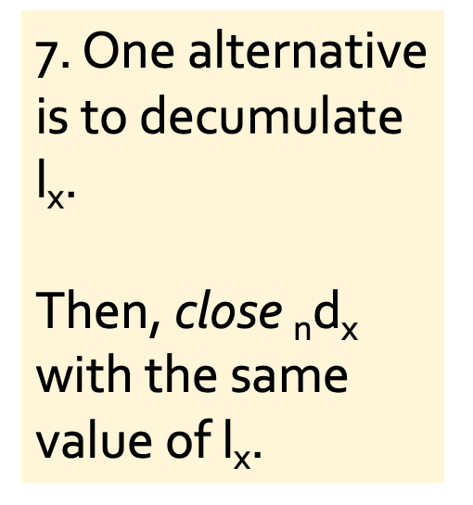
1. Life table for an unspecified West African population, 1975
x | _{n}m_{x} | n | _{n}a_{x} | _{n}q_{x} | _{n}p_{x} | l_{x} | _{n}d_{x} | _{n}L_{x} | T_{x} | e_{x}
0 | 0.22650 | 1 | 0.3 | 0.19550 | 0.80450 | 100,000 | 19,550
1 | 0.03430 | 4 | 0.4 | 0.12676 | 0.87324 | 80,450 | 10,198
5 | 0.00198 | 5 | 0.5 | 0.00985 | 0.99015 | 70,252 | 692
10 | 0.00038 | 5 | 0.5 | 0.00190 | 0.99810 | 69,559 | 132
15 | 0.00180 | 5 | 0.5 | 0.00896 | 0.99104 | 69,427 | 622
20 | 0.00252 | 5 | 0.5 | 0.01252 | 0.98748 | 68,805 | 862
25 | 0.00290 | 5 | 0.5 | 0.01440 | 0.98560 | 67,944 | 978
30 | 0.00318 | 5 | 0.5 | 0.01577 | 0.98423 | 66,966 | 1,056
35 | 0.00352 | 5 | 0.5 | 0.01745 | 0.98255 | 65,909 | 1,150
40 | 0.00390 | 5 | 0.5 | 0.01931 | 0.98069 | 64,760 | 1,251
45 | 0.00454 | 5 | 0.5 | 0.02245 | 0.97755 | 63,509 | 1,425
50 | 0.00490 | 5 | 0.5 | 0.02420 | 0.97580 | 62,083 | 1,503
55 | 0.00622 | 5 | 0.5 | 0.03062 | 0.96938 | 60,581 | 1,855
60 | 0.00998 | 5 | 0.5 | 0.04869 | 0.95131 | 58,726 | 2,859
65 | 0.02066 | 5 | 0.5 | 0.09823 | 0.90177 | 55,866 | 5,488
70 | 0.06748 | 5 | 0.5 | 0.28870 | 0.71130 | 50,379 | 14,544
75+ | 0.31780 |  |  | 1.00000 | 0.00000 | 35,835 | 35,835
7. One alternative is to decumulate l_{x}.
Then, close $\text{n}\text{d}\text{x}$ with the same value of l_{x}.

Slide 21

1. Life table for an unspecified West African population, 1975
x | _{n}m_{x} | n | _{n}a_{x} | _{n}q_{x} | _{n}p_{x} | l_{x} | _{n}d_{x} | _{n}L_{x} | T_{x} | e_{x}
0 | 0.22650 | 1 | 0.3 | 0.19550 | 0.80450 | 100,000 | 19,550 | 86,315
1 | 0.03430 | 4 | 0.4 | 0.12676 | 0.87324 | 80,450 | 10,198 | 297,323
5 | 0.00198 | 5 | 0.5 | 0.00985 | 0.99015 | 70,252 | 692 | 349,527
10 | 0.00038 | 5 | 0.5 | 0.00190 | 0.99810 | 69,559 | 132 | 347,467
15 | 0.00180 | 5 | 0.5 | 0.00896 | 0.99104 | 69,427 | 622 | 345,582
20 | 0.00252 | 5 | 0.5 | 0.01252 | 0.98748 | 68,805 | 862 | 341,873
25 | 0.00290 | 5 | 0.5 | 0.01440 | 0.98560 | 67,944 | 978 | 337,274
30 | 0.00318 | 5 | 0.5 | 0.01577 | 0.98423 | 66,966 | 1,056 | 332,188
35 | 0.00352 | 5 | 0.5 | 0.01745 | 0.98255 | 65,909 | 1,150 | 326,672
40 | 0.00390 | 5 | 0.5 | 0.01931 | 0.98069 | 64,760 | 1,251 | 320,671
45 | 0.00454 | 5 | 0.5 | 0.02245 | 0.97755 | 63,509 | 1,425 | 313,981
50 | 0.00490 | 5 | 0.5 | 0.02420 | 0.97580 | 62,083 | 1,503 | 306,661
55 | 0.00622 | 5 | 0.5 | 0.03062 | 0.96938 | 60,581 | 1,855 | 298,266
60 | 0.00998 | 5 | 0.5 | 0.04869 | 0.95131 | 58,726 | 2,859 | 286,480
65 | 0.02066 | 5 | 0.5 | 0.09823 | 0.90177 | 55,866 | 5,488 | 265,614
70 | 0.06748 | 5 | 0.5 | 0.28870 | 0.71130 | 50,379 | 14,544 | 215,534
75+ | 0.31780 |  |  | 1.00000 | 0.00000 | 35,835 | 35,835
8. Use a formula to calculate $\text{n}\text{L}\text{x}$.
$$\text{n}\text{L}\text{x}=\text{n}∙\left(\text{l}\text{x}−\text{n}\text{d}\text{x}\right)\text{+}\text{n}∙\text{n}\text{a}\text{x}∙\text{n}\text{d}\text{x}$$
$\text{n}\text{L}\text{x}$ is the number of person-years lived in the age interval. While each survivor contributes with n years (in blue), each deceased contributes n times $\text{n}\text{a}\text{x}$ years (in red).

Slide 22

1. Life table for an unspecified West African population, 1975
x | _{n}m_{x} | n | _{n}a_{x} | _{n}q_{x} | _{n}p_{x} | l_{x} | _{n}d_{x} | _{n}L_{x} | T_{x} | e_{x}
0 | 0.22650 | 1 | 0.3 | 0.19550 | 0.80450 | 100,000 | 19,550 | 86,315
1 | 0.03430 | 4 | 0.4 | 0.12676 | 0.87324 | 80,450 | 10,198 | 297,323
5 | 0.00198 | 5 | 0.5 | 0.00985 | 0.99015 | 70,252 | 692 | 349,527
10 | 0.00038 | 5 | 0.5 | 0.00190 | 0.99810 | 69,559 | 132 | 347,467
15 | 0.00180 | 5 | 0.5 | 0.00896 | 0.99104 | 69,427 | 622 | 345,582
20 | 0.00252 | 5 | 0.5 | 0.01252 | 0.98748 | 68,805 | 862 | 341,873
25 | 0.00290 | 5 | 0.5 | 0.01440 | 0.98560 | 67,944 | 978 | 337,274
30 | 0.00318 | 5 | 0.5 | 0.01577 | 0.98423 | 66,966 | 1,056 | 332,188
35 | 0.00352 | 5 | 0.5 | 0.01745 | 0.98255 | 65,909 | 1,150 | 326,672
40 | 0.00390 | 5 | 0.5 | 0.01931 | 0.98069 | 64,760 | 1,251 | 320,671
45 | 0.00454 | 5 | 0.5 | 0.02245 | 0.97755 | 63,509 | 1,425 | 313,981
50 | 0.00490 | 5 | 0.5 | 0.02420 | 0.97580 | 62,083 | 1,503 | 306,661
55 | 0.00622 | 5 | 0.5 | 0.03062 | 0.96938 | 60,581 | 1,855 | 298,266
60 | 0.00998 | 5 | 0.5 | 0.04869 | 0.95131 | 58,726 | 2,859 | 286,480
65 | 0.02066 | 5 | 0.5 | 0.09823 | 0.90177 | 55,866 | 5,488 | 265,614
70 | 0.06748 | 5 | 0.5 | 0.28870 | 0.71130 | 50,379 | 14,544 | 215,534
75+ | 0.31780 |  |  | 1.00000 | 0.00000 | 35,835 | 35,835 | 112,759
8. Use a formula to close $\text{n}\text{L}\text{x}$ at the open-ended age interval.
$$\text{n}\text{L}\text{x}=\frac{\text{n}\text{d}\text{x}}{\text{n}\text{m}\text{x}}$$
This equation can be used for all age groups; if and only if $\text{n}\text{m}\text{x}$ is greater than zero, which is always the case of the open-ended age interval.

Slide 23
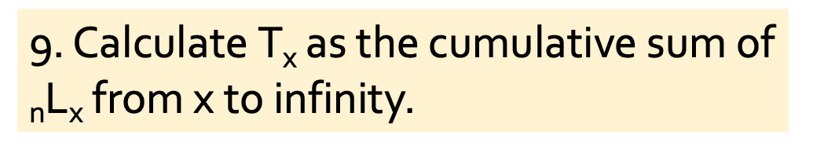
1. Life table for an unspecified West African population, 1975
x | _{n}m_{x} | n | _{n}a_{x} | _{n}q_{x} | _{n}p_{x} | l_{x} | _{n}d_{x} | _{n}L_{x} | T_{x} | e_{x}
0 | 0.22650 | 1 | 0.3 | 0.19550 | 0.80450 | 100,000 | 19,550 | 86,315 | 4,884,186
1 | 0.03430 | 4 | 0.4 | 0.12676 | 0.87324 | 80,450 | 10,198 | 297,323
5 | 0.00198 | 5 | 0.5 | 0.00985 | 0.99015 | 70,252 | 692 | 349,527
10 | 0.00038 | 5 | 0.5 | 0.00190 | 0.99810 | 69,559 | 132 | 347,467
15 | 0.00180 | 5 | 0.5 | 0.00896 | 0.99104 | 69,427 | 622 | 345,582
20 | 0.00252 | 5 | 0.5 | 0.01252 | 0.98748 | 68,805 | 862 | 341,873
25 | 0.00290 | 5 | 0.5 | 0.01440 | 0.98560 | 67,944 | 978 | 337,274
30 | 0.00318 | 5 | 0.5 | 0.01577 | 0.98423 | 66,966 | 1,056 | 332,188
35 | 0.00352 | 5 | 0.5 | 0.01745 | 0.98255 | 65,909 | 1,150 | 326,672
40 | 0.00390 | 5 | 0.5 | 0.01931 | 0.98069 | 64,760 | 1,251 | 320,671
45 | 0.00454 | 5 | 0.5 | 0.02245 | 0.97755 | 63,509 | 1,425 | 313,981
50 | 0.00490 | 5 | 0.5 | 0.02420 | 0.97580 | 62,083 | 1,503 | 306,661
55 | 0.00622 | 5 | 0.5 | 0.03062 | 0.96938 | 60,581 | 1,855 | 298,266
60 | 0.00998 | 5 | 0.5 | 0.04869 | 0.95131 | 58,726 | 2,859 | 286,480
65 | 0.02066 | 5 | 0.5 | 0.09823 | 0.90177 | 55,866 | 5,488 | 265,614
70 | 0.06748 | 5 | 0.5 | 0.28870 | 0.71130 | 50,379 | 14,544 | 215,534
75+ | 0.31780 |  |  | 1.00000 | 0.00000 | 35,835 | 35,835 | 112,759
9. Calculate $\text{T}\text{x}$ as the cumulative sum of $\text{n}\text{L}\text{x}$ from x to infinity.

Slide 24
1. Life table for an unspecified West African population, 1975
x | _{n}m_{x} | n | _{n}a_{x} | _{n}q_{x} | _{n}p_{x} | l_{x} | _{n}d_{x} | _{n}L_{x} | T_{x} | e_{x}
0 | 0.22650 | 1 | 0.3 | 0.19550 | 0.80450 | 100,000 | 19,550 | 86,315 | 4,884,186
1 | 0.03430 | 4 | 0.4 | 0.12676 | 0.87324 | 80,450 | 10,198 | 297,323 | 4,797,871
5 | 0.00198 | 5 | 0.5 | 0.00985 | 0.99015 | 70,252 | 692 | 349,527
10 | 0.00038 | 5 | 0.5 | 0.00190 | 0.99810 | 69,559 | 132 | 347,467
15 | 0.00180 | 5 | 0.5 | 0.00896 | 0.99104 | 69,427 | 622 | 345,582
20 | 0.00252 | 5 | 0.5 | 0.01252 | 0.98748 | 68,805 | 862 | 341,873
25 | 0.00290 | 5 | 0.5 | 0.01440 | 0.98560 | 67,944 | 978 | 337,274
30 | 0.00318 | 5 | 0.5 | 0.01577 | 0.98423 | 66,966 | 1,056 | 332,188
35 | 0.00352 | 5 | 0.5 | 0.01745 | 0.98255 | 65,909 | 1,150 | 326,672
40 | 0.00390 | 5 | 0.5 | 0.01931 | 0.98069 | 64,760 | 1,251 | 320,671
45 | 0.00454 | 5 | 0.5 | 0.02245 | 0.97755 | 63,509 | 1,425 | 313,981
50 | 0.00490 | 5 | 0.5 | 0.02420 | 0.97580 | 62,083 | 1,503 | 306,661
55 | 0.00622 | 5 | 0.5 | 0.03062 | 0.96938 | 60,581 | 1,855 | 298,266
60 | 0.00998 | 5 | 0.5 | 0.04869 | 0.95131 | 58,726 | 2,859 | 286,480
65 | 0.02066 | 5 | 0.5 | 0.09823 | 0.90177 | 55,866 | 5,488 | 265,614
70 | 0.06748 | 5 | 0.5 | 0.28870 | 0.71130 | 50,379 | 14,544 | 215,534
75+ | 0.31780 |  |  | 1.00000 | 0.00000 | 35,835 | 35,835 | 112,759
9. Calculate $\text{T}\text{x}$ as the cumulative sum of $\text{n}\text{L}\text{x}$ from x to infinity.

Slide 25
1. Life table for an unspecified West African population, 1975
x | _{n}m_{x} | n | _{n}a_{x} | _{n}q_{x} | _{n}p_{x} | l_{x} | _{n}d_{x} | _{n}L_{x} | T_{x} | e_{x}
0 | 0.22650 | 1 | 0.3 | 0.19550 | 0.80450 | 100,000 | 19,550 | 86,315 | 4,884,186
1 | 0.03430 | 4 | 0.4 | 0.12676 | 0.87324 | 80,450 | 10,198 | 297,323 | 4,797,871
5 | 0.00198 | 5 | 0.5 | 0.00985 | 0.99015 | 70,252 | 692 | 349,527 | 4,500,548
10 | 0.00038 | 5 | 0.5 | 0.00190 | 0.99810 | 69,559 | 132 | 347,467
15 | 0.00180 | 5 | 0.5 | 0.00896 | 0.99104 | 69,427 | 622 | 345,582
20 | 0.00252 | 5 | 0.5 | 0.01252 | 0.98748 | 68,805 | 862 | 341,873
25 | 0.00290 | 5 | 0.5 | 0.01440 | 0.98560 | 67,944 | 978 | 337,274
30 | 0.00318 | 5 | 0.5 | 0.01577 | 0.98423 | 66,966 | 1,056 | 332,188
35 | 0.00352 | 5 | 0.5 | 0.01745 | 0.98255 | 65,909 | 1,150 | 326,672
40 | 0.00390 | 5 | 0.5 | 0.01931 | 0.98069 | 64,760 | 1,251 | 320,671
45 | 0.00454 | 5 | 0.5 | 0.02245 | 0.97755 | 63,509 | 1,425 | 313,981
50 | 0.00490 | 5 | 0.5 | 0.02420 | 0.97580 | 62,083 | 1,503 | 306,661
55 | 0.00622 | 5 | 0.5 | 0.03062 | 0.96938 | 60,581 | 1,855 | 298,266
60 | 0.00998 | 5 | 0.5 | 0.04869 | 0.95131 | 58,726 | 2,859 | 286,480
65 | 0.02066 | 5 | 0.5 | 0.09823 | 0.90177 | 55,866 | 5,488 | 265,614
70 | 0.06748 | 5 | 0.5 | 0.28870 | 0.71130 | 50,379 | 14,544 | 215,534
75+ | 0.31780 |  |  | 1.00000 | 0.00000 | 35,835 | 35,835 | 112,759
9. Calculate $\text{T}\text{x}$ as the cumulative sum of $\text{n}\text{L}\text{x}$ from x to infinity.

Slide 26
1. Life table for an unspecified West African population, 1975
x | _{n}m_{x} | n | _{n}a_{x} | _{n}q_{x} | _{n}p_{x} | l_{x} | _{n}d_{x} | _{n}L_{x} | T_{x} | e_{x}
0 | 0.22650 | 1 | 0.3 | 0.19550 | 0.80450 | 100,000 | 19,550 | 86,315 | 4,884,186
1 | 0.03430 | 4 | 0.4 | 0.12676 | 0.87324 | 80,450 | 10,198 | 297,323 | 4,797,871
5 | 0.00198 | 5 | 0.5 | 0.00985 | 0.99015 | 70,252 | 692 | 349,527 | 4,500,548
10 | 0.00038 | 5 | 0.5 | 0.00190 | 0.99810 | 69,559 | 132 | 347,467 | 4,151,021
15 | 0.00180 | 5 | 0.5 | 0.00896 | 0.99104 | 69,427 | 622 | 345,582 | 3,803,554
20 | 0.00252 | 5 | 0.5 | 0.01252 | 0.98748 | 68,805 | 862 | 341,873 | 3,457,972
25 | 0.00290 | 5 | 0.5 | 0.01440 | 0.98560 | 67,944 | 978 | 337,274 | 3,116,099
30 | 0.00318 | 5 | 0.5 | 0.01577 | 0.98423 | 66,966 | 1,056 | 332,188 | 2,778,825
35 | 0.00352 | 5 | 0.5 | 0.01745 | 0.98255 | 65,909 | 1,150 | 326,672 | 2,446,637
40 | 0.00390 | 5 | 0.5 | 0.01931 | 0.98069 | 64,760 | 1,251 | 320,671 | 2,119,964
45 | 0.00454 | 5 | 0.5 | 0.02245 | 0.97755 | 63,509 | 1,425 | 313,981 | 1,799,293
50 | 0.00490 | 5 | 0.5 | 0.02420 | 0.97580 | 62,083 | 1,503 | 306,661 | 1,485,313
55 | 0.00622 | 5 | 0.5 | 0.03062 | 0.96938 | 60,581 | 1,855 | 298,266 | 1,178,652
60 | 0.00998 | 5 | 0.5 | 0.04869 | 0.95131 | 58,726 | 2,859 | 286,480 | 880,386
65 | 0.02066 | 5 | 0.5 | 0.09823 | 0.90177 | 55,866 | 5,488 | 265,614 | 593,906
70 | 0.06748 | 5 | 0.5 | 0.28870 | 0.71130 | 50,379 | 14,544 | 215,534 | 328,293
75+ | 0.31780 |  |  | 1.00000 | 0.00000 | 35,835 | 35,835 | 112,759
9. Calculate $\text{T}\text{x}$ as the cumulative sum of $\text{n}\text{L}\text{x}$ from x to infinity.

Slide 27

1. Life table for an unspecified West African population, 1975
x | _{n}m_{x} | n | _{n}a_{x} | _{n}q_{x} | _{n}p_{x} | l_{x} | _{n}d_{x} | _{n}L_{x} | T_{x} | e_{x}
0 | 0.22650 | 1 | 0.3 | 0.19550 | 0.80450 | 100,000 | 19,550 | 86,315 | 4,884,186
1 | 0.03430 | 4 | 0.4 | 0.12676 | 0.87324 | 80,450 | 10,198 | 297,323 | 4,797,871
5 | 0.00198 | 5 | 0.5 | 0.00985 | 0.99015 | 70,252 | 692 | 349,527 | 4,500,548
10 | 0.00038 | 5 | 0.5 | 0.00190 | 0.99810 | 69,559 | 132 | 347,467 | 4,151,021
15 | 0.00180 | 5 | 0.5 | 0.00896 | 0.99104 | 69,427 | 622 | 345,582 | 3,803,554
20 | 0.00252 | 5 | 0.5 | 0.01252 | 0.98748 | 68,805 | 862 | 341,873 | 3,457,972
25 | 0.00290 | 5 | 0.5 | 0.01440 | 0.98560 | 67,944 | 978 | 337,274 | 3,116,099
30 | 0.00318 | 5 | 0.5 | 0.01577 | 0.98423 | 66,966 | 1,056 | 332,188 | 2,778,825
35 | 0.00352 | 5 | 0.5 | 0.01745 | 0.98255 | 65,909 | 1,150 | 326,672 | 2,446,637
40 | 0.00390 | 5 | 0.5 | 0.01931 | 0.98069 | 64,760 | 1,251 | 320,671 | 2,119,964
45 | 0.00454 | 5 | 0.5 | 0.02245 | 0.97755 | 63,509 | 1,425 | 313,981 | 1,799,293
50 | 0.00490 | 5 | 0.5 | 0.02420 | 0.97580 | 62,083 | 1,503 | 306,661 | 1,485,313
55 | 0.00622 | 5 | 0.5 | 0.03062 | 0.96938 | 60,581 | 1,855 | 298,266 | 1,178,652
60 | 0.00998 | 5 | 0.5 | 0.04869 | 0.95131 | 58,726 | 2,859 | 286,480 | 880,386
65 | 0.02066 | 5 | 0.5 | 0.09823 | 0.90177 | 55,866 | 5,488 | 265,614 | 593,906
70 | 0.06748 | 5 | 0.5 | 0.28870 | 0.71130 | 50,379 | 14,544 | 215,534 | 328,293
75+ | 0.31780 |  |  | 1.00000 | 0.00000 | 35,835 | 35,835 | 112,759 | 112,759
9. Calculate $\text{T}\text{x}$ as the cumulative sum of $\text{n}\text{L}\text{x}$ from x to infinity.
By construction, $\text{T}\text{x}$ and $\text{n}\text{L}\text{x}$ should have the same value at the open-ended age interval.

Slide 28

1. Life table for an unspecified West African population, 1975
x | _{n}m_{x} | n | _{n}a_{x} | _{n}q_{x} | _{n}p_{x} | l_{x} | _{n}d_{x} | _{n}L_{x} | T_{x} | e_{x}
0 | 0.22650 | 1 | 0.3 | 0.19550 | 0.80450 | 100,000 | 19,550 | 86,315 | 4,884,186 | 48.84
1 | 0.03430 | 4 | 0.4 | 0.12676 | 0.87324 | 80,450 | 10,198 | 297,323 | 4,797,871 | 59.64
5 | 0.00198 | 5 | 0.5 | 0.00985 | 0.99015 | 70,252 | 692 | 349,527 | 4,500,548 | 64.06
10 | 0.00038 | 5 | 0.5 | 0.00190 | 0.99810 | 69,559 | 132 | 347,467 | 4,151,021 | 59.68
15 | 0.00180 | 5 | 0.5 | 0.00896 | 0.99104 | 69,427 | 622 | 345,582 | 3,803,554 | 54.78
20 | 0.00252 | 5 | 0.5 | 0.01252 | 0.98748 | 68,805 | 862 | 341,873 | 3,457,972 | 50.26
25 | 0.00290 | 5 | 0.5 | 0.01440 | 0.98560 | 67,944 | 978 | 337,274 | 3,116,099 | 45.86
30 | 0.00318 | 5 | 0.5 | 0.01577 | 0.98423 | 66,966 | 1,056 | 332,188 | 2,778,825 | 41.50
35 | 0.00352 | 5 | 0.5 | 0.01745 | 0.98255 | 65,909 | 1,150 | 326,672 | 2,446,637 | 37.12
40 | 0.00390 | 5 | 0.5 | 0.01931 | 0.98069 | 64,760 | 1,251 | 320,671 | 2,119,964 | 32.74
45 | 0.00454 | 5 | 0.5 | 0.02245 | 0.97755 | 63,509 | 1,425 | 313,981 | 1,799,293 | 28.33
50 | 0.00490 | 5 | 0.5 | 0.02420 | 0.97580 | 62,083 | 1,503 | 306,661 | 1,485,313 | 23.92
55 | 0.00622 | 5 | 0.5 | 0.03062 | 0.96938 | 60,581 | 1,855 | 298,266 | 1,178,652 | 19.46
60 | 0.00998 | 5 | 0.5 | 0.04869 | 0.95131 | 58,726 | 2,859 | 286,480 | 880,386 | 14.99
65 | 0.02066 | 5 | 0.5 | 0.09823 | 0.90177 | 55,866 | 5,488 | 265,614 | 593,906 | 10.63
70 | 0.06748 | 5 | 0.5 | 0.28870 | 0.71130 | 50,379 | 14,544 | 215,534 | 328,293 | 6.52
75+ | 0.31780 |  |  | 1.00000 | 0.00000 | 35,835 | 35,835 | 112,759 | 112,759 | 3.15
10. Calculate $\text{e}\text{x}$ as a function of $\text{T}\text{x}$ and $\text{l}\text{x}$.
$$\text{e}\text{x}=\frac{\text{T}\text{x}}{\text{l}\text{x}}$$

Slide 29
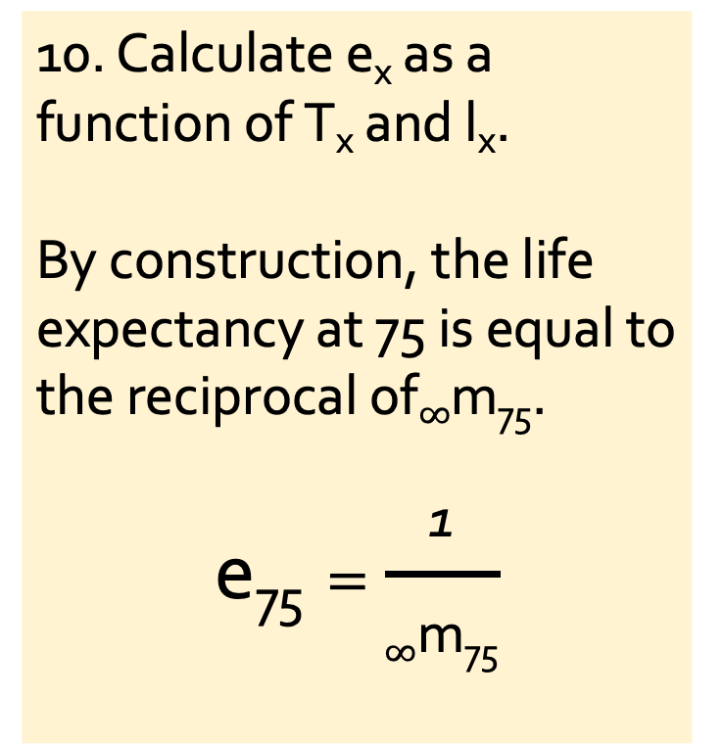
1. Life table for an unspecified West African population, 1975
x | _{n}m_{x} | n | _{n}a_{x} | _{n}q_{x} | _{n}p_{x} | l_{x} | _{n}d_{x} | _{n}L_{x} | T_{x} | e_{x}
0 | 0.22650 | 1 | 0.3 | 0.19550 | 0.80450 | 100,000 | 19,550 | 86,315 | 4,884,186 | 48.84
1 | 0.03430 | 4 | 0.4 | 0.12676 | 0.87324 | 80,450 | 10,198 | 297,323 | 4,797,871 | 59.64
5 | 0.00198 | 5 | 0.5 | 0.00985 | 0.99015 | 70,252 | 692 | 349,527 | 4,500,548 | 64.06
10 | 0.00038 | 5 | 0.5 | 0.00190 | 0.99810 | 69,559 | 132 | 347,467 | 4,151,021 | 59.68
15 | 0.00180 | 5 | 0.5 | 0.00896 | 0.99104 | 69,427 | 622 | 345,582 | 3,803,554 | 54.78
20 | 0.00252 | 5 | 0.5 | 0.01252 | 0.98748 | 68,805 | 862 | 341,873 | 3,457,972 | 50.26
25 | 0.00290 | 5 | 0.5 | 0.01440 | 0.98560 | 67,944 | 978 | 337,274 | 3,116,099 | 45.86
30 | 0.00318 | 5 | 0.5 | 0.01577 | 0.98423 | 66,966 | 1,056 | 332,188 | 2,778,825 | 41.50
35 | 0.00352 | 5 | 0.5 | 0.01745 | 0.98255 | 65,909 | 1,150 | 326,672 | 2,446,637 | 37.12
40 | 0.00390 | 5 | 0.5 | 0.01931 | 0.98069 | 64,760 | 1,251 | 320,671 | 2,119,964 | 32.74
45 | 0.00454 | 5 | 0.5 | 0.02245 | 0.97755 | 63,509 | 1,425 | 313,981 | 1,799,293 | 28.33
50 | 0.00490 | 5 | 0.5 | 0.02420 | 0.97580 | 62,083 | 1,503 | 306,661 | 1,485,313 | 23.92
55 | 0.00622 | 5 | 0.5 | 0.03062 | 0.96938 | 60,581 | 1,855 | 298,266 | 1,178,652 | 19.46
60 | 0.00998 | 5 | 0.5 | 0.04869 | 0.95131 | 58,726 | 2,859 | 286,480 | 880,386 | 14.99
65 | 0.02066 | 5 | 0.5 | 0.09823 | 0.90177 | 55,866 | 5,488 | 265,614 | 593,906 | 10.63
70 | 0.06748 | 5 | 0.5 | 0.28870 | 0.71130 | 50,379 | 14,544 | 215,534 | 328,293 | 6.52
75+ | 0.31780 |  |  | 1.00000 | 0.00000 | 35,835 | 35,835 | 112,759 | 112,759 | 3.15
10. Calculate $\text{e}\text{x}$ as a function of $\text{T}\text{x}$ and $\text{l}\text{x}$.
By construction, the life expectancy at 75 is equal to the reciprocal of$∞\text{m}\text{75}$.
$$\text{e}\text{75}=\frac{\text{1}}{∞\text{m}\text{75}}$$

Slide 30
…Thanks!

